Slide 1
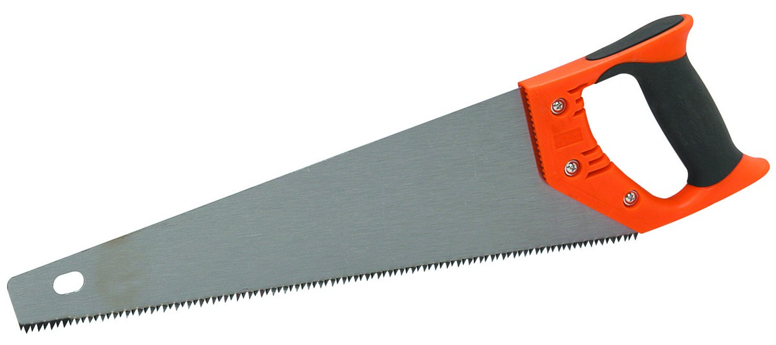
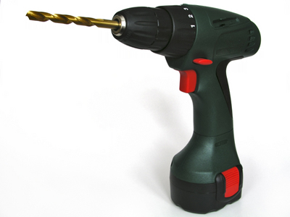
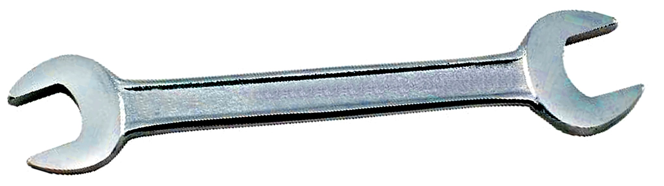
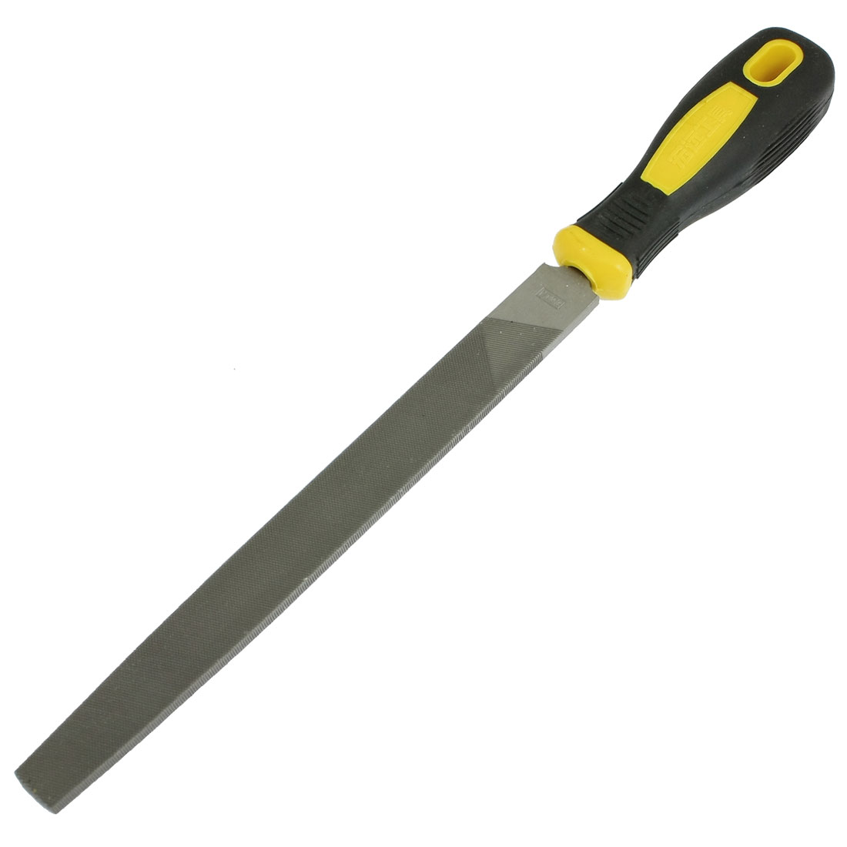
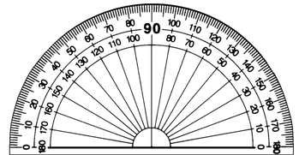
Tools Required
Hand saw
Hand drill
Spanners (various sizes)
File
Protractor

Slide 2
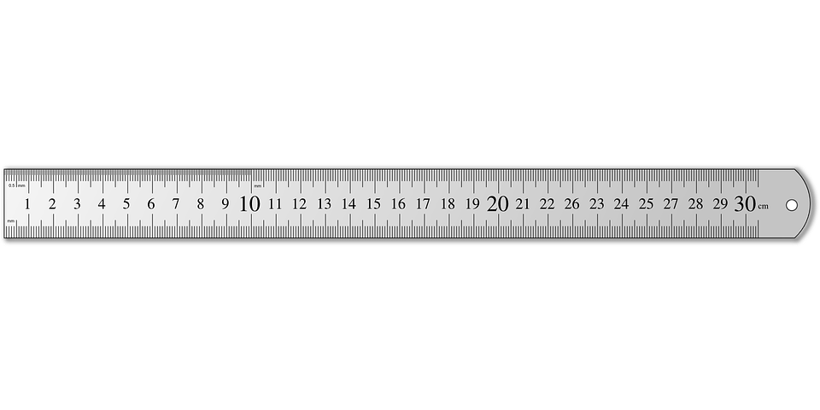
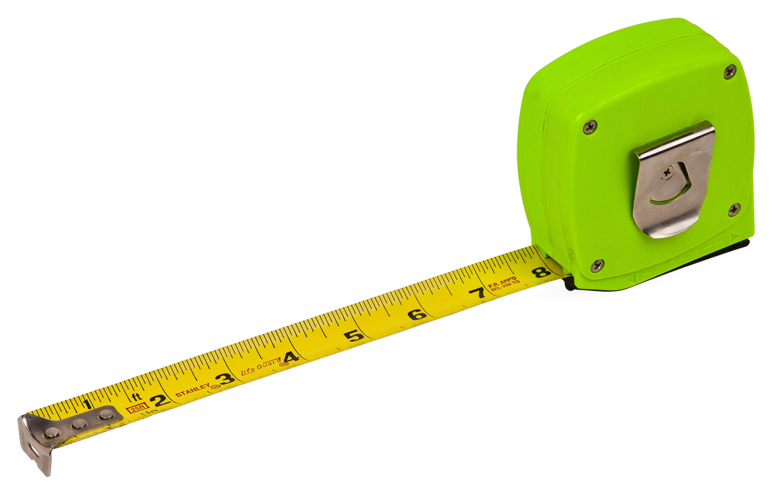

Tools Required
Ruler
Tape measure
Threadlock

Slide 3
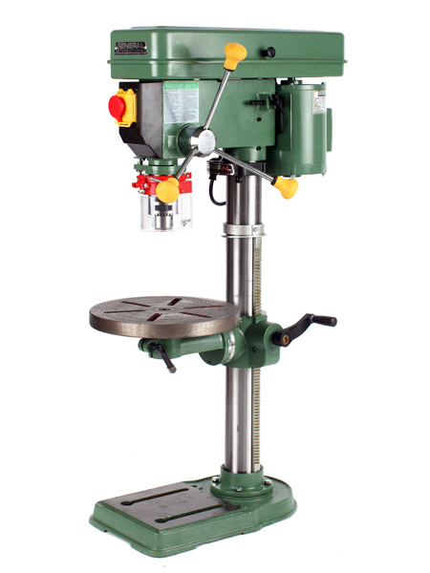
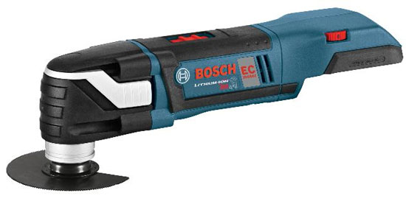
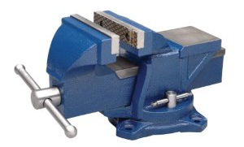
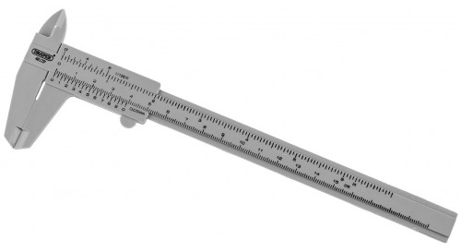
Optional Tools
Drill press
Power saw
Bench vice
Callipers

Slide 4
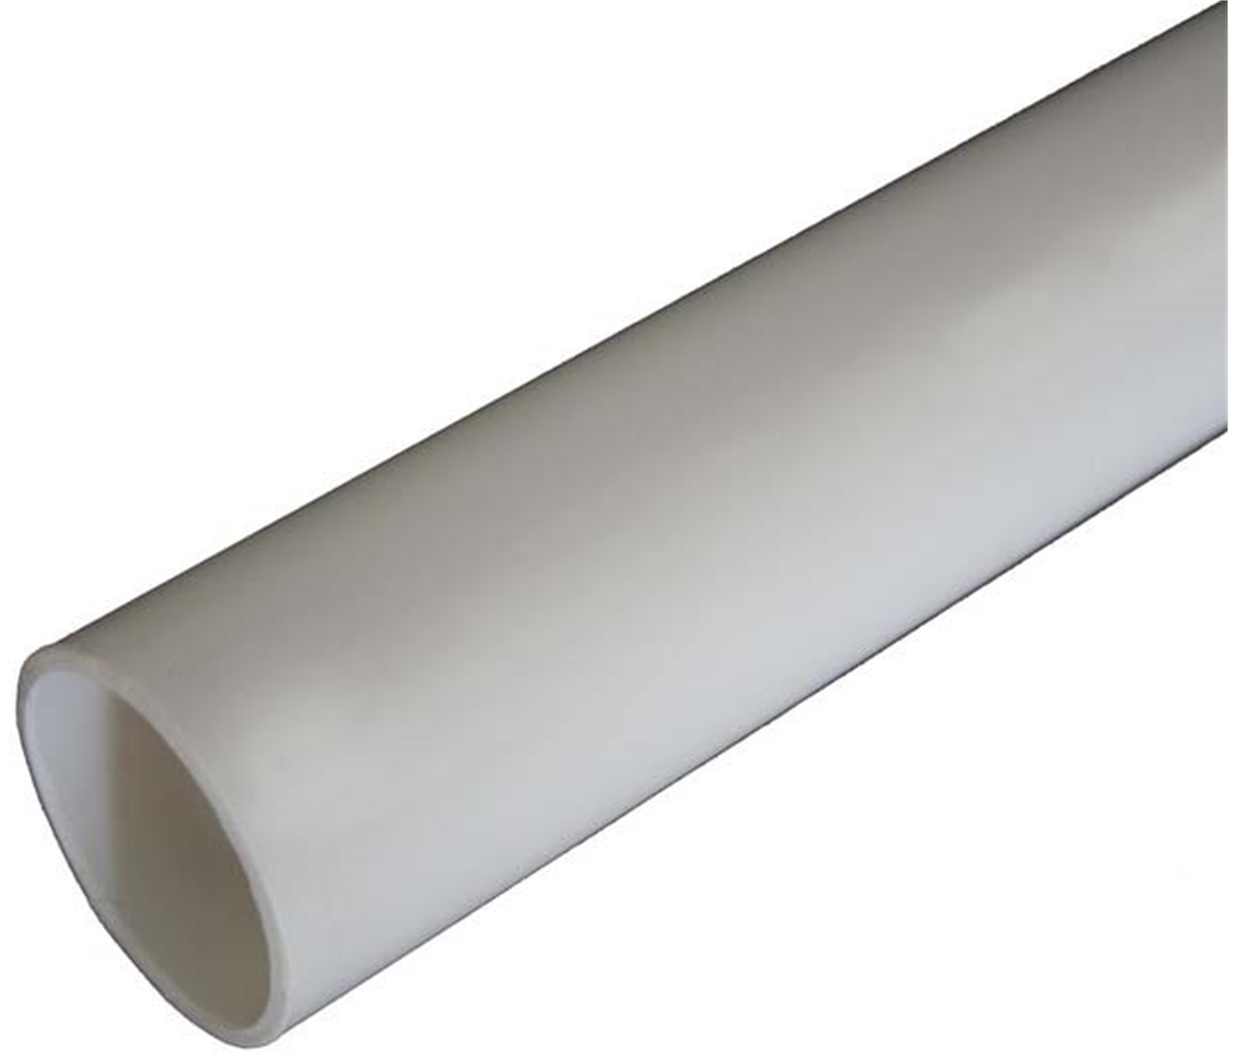
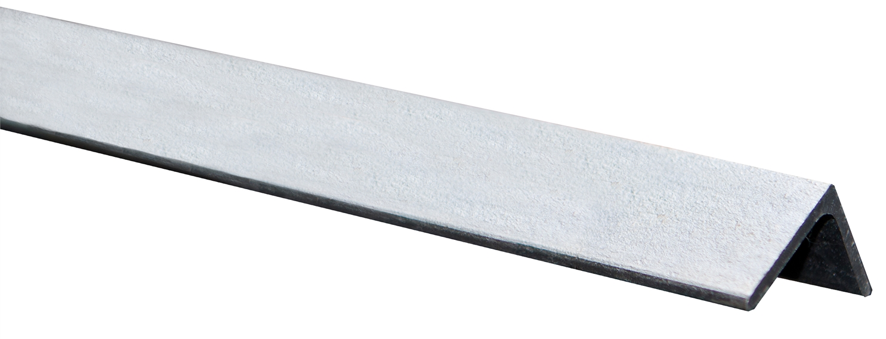
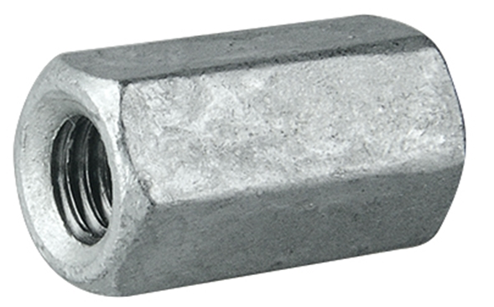
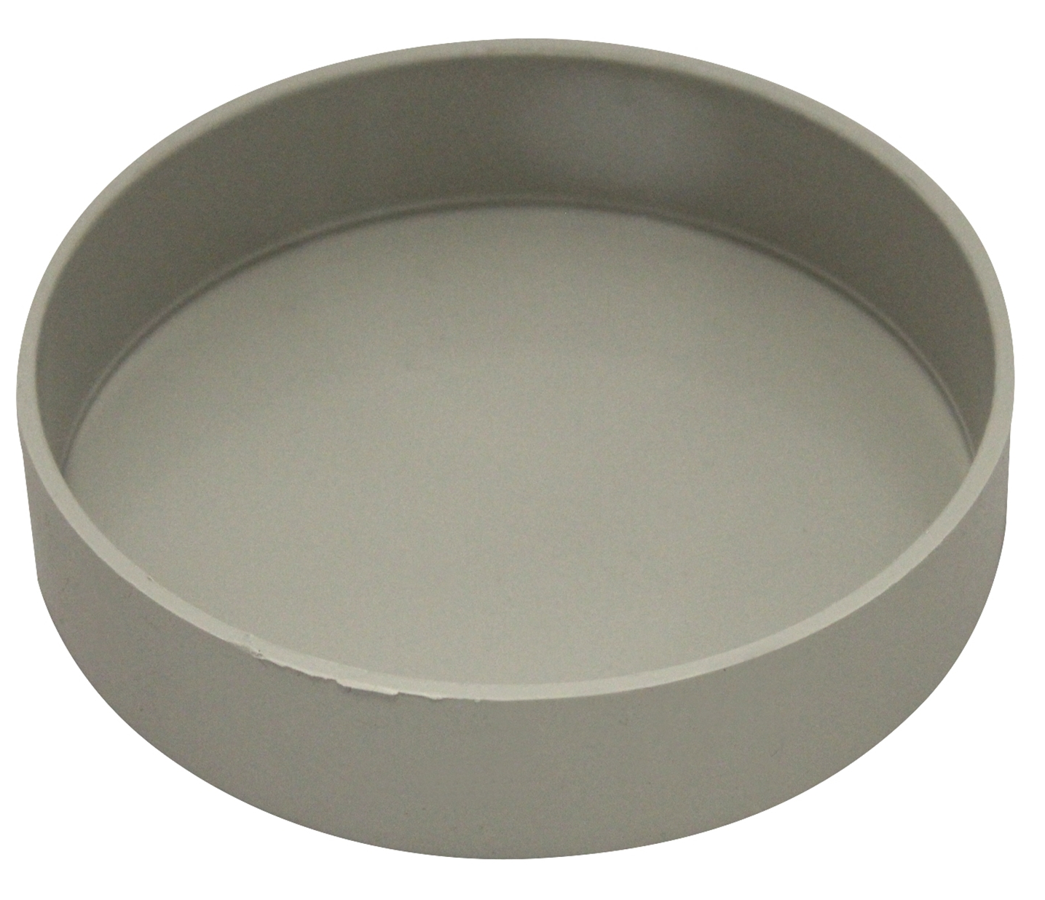
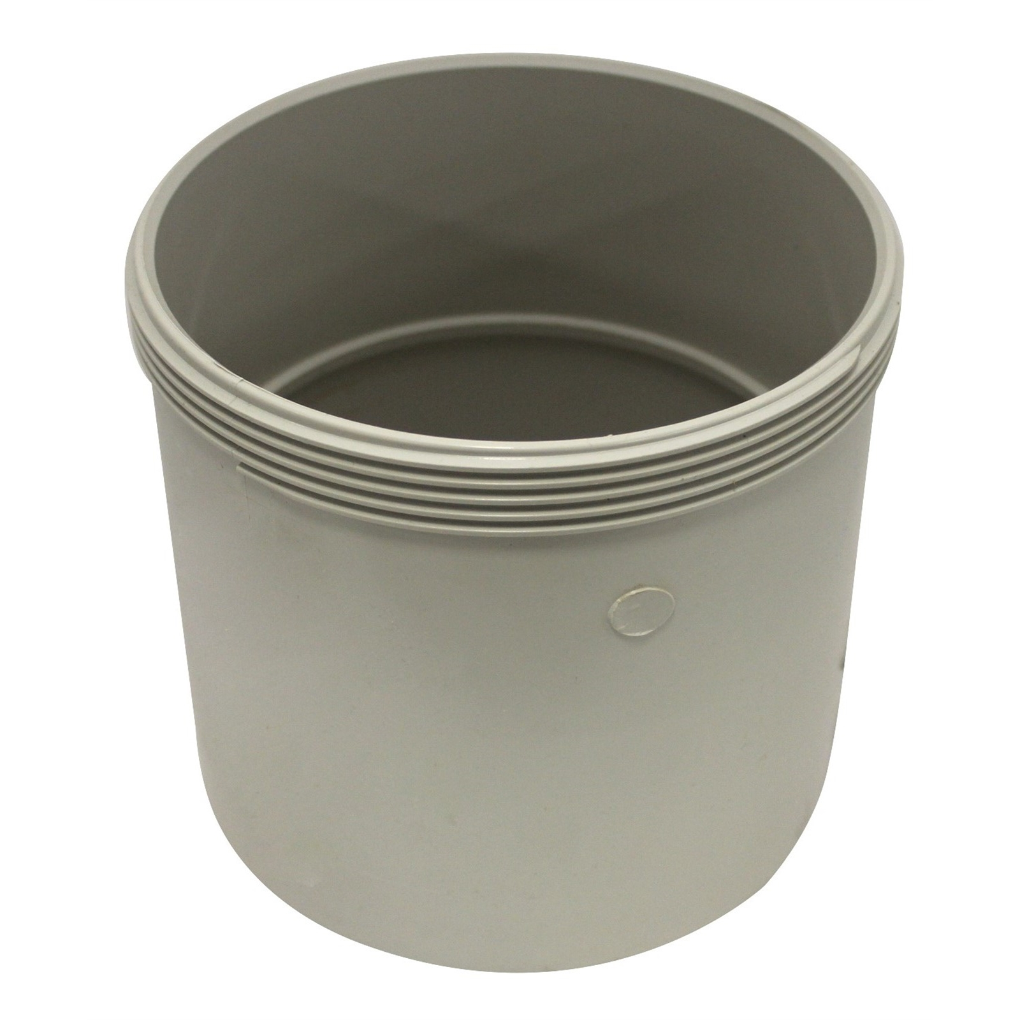
Materials
90mm x 1m PVC pipe | x1
12x12x1.4mm Angle Iron (0.5m long) | x1
M16 x 60mm hex coupler | x1
100mm PVC end cap | x1
150mm PVC threaded access coupling | x1

Slide 5
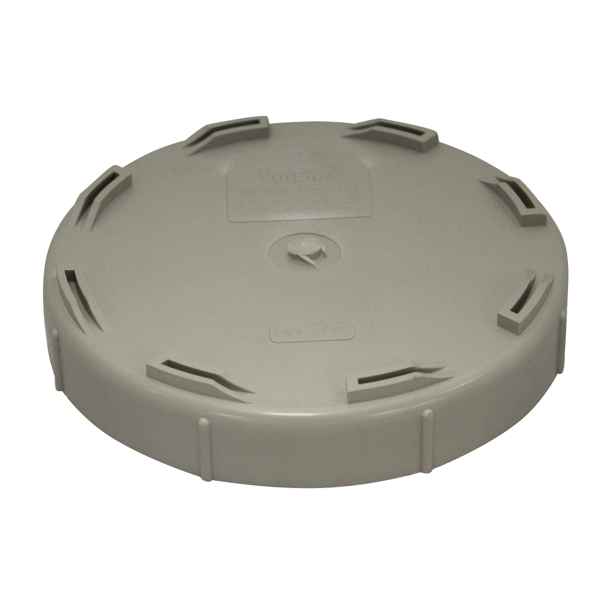
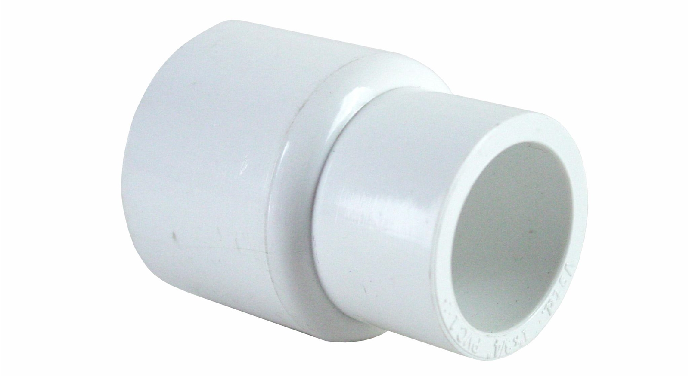
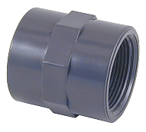
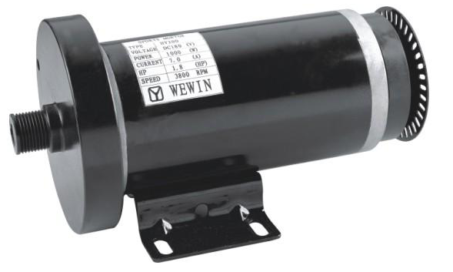
Materials
150mm PVC threaded end cap | x1
150mm PVC end cap | x1
20mm to 15mm PVC reducer | x1
15mm PVC male thread adapter | x1
Treadmill motor | x1

Slide 6
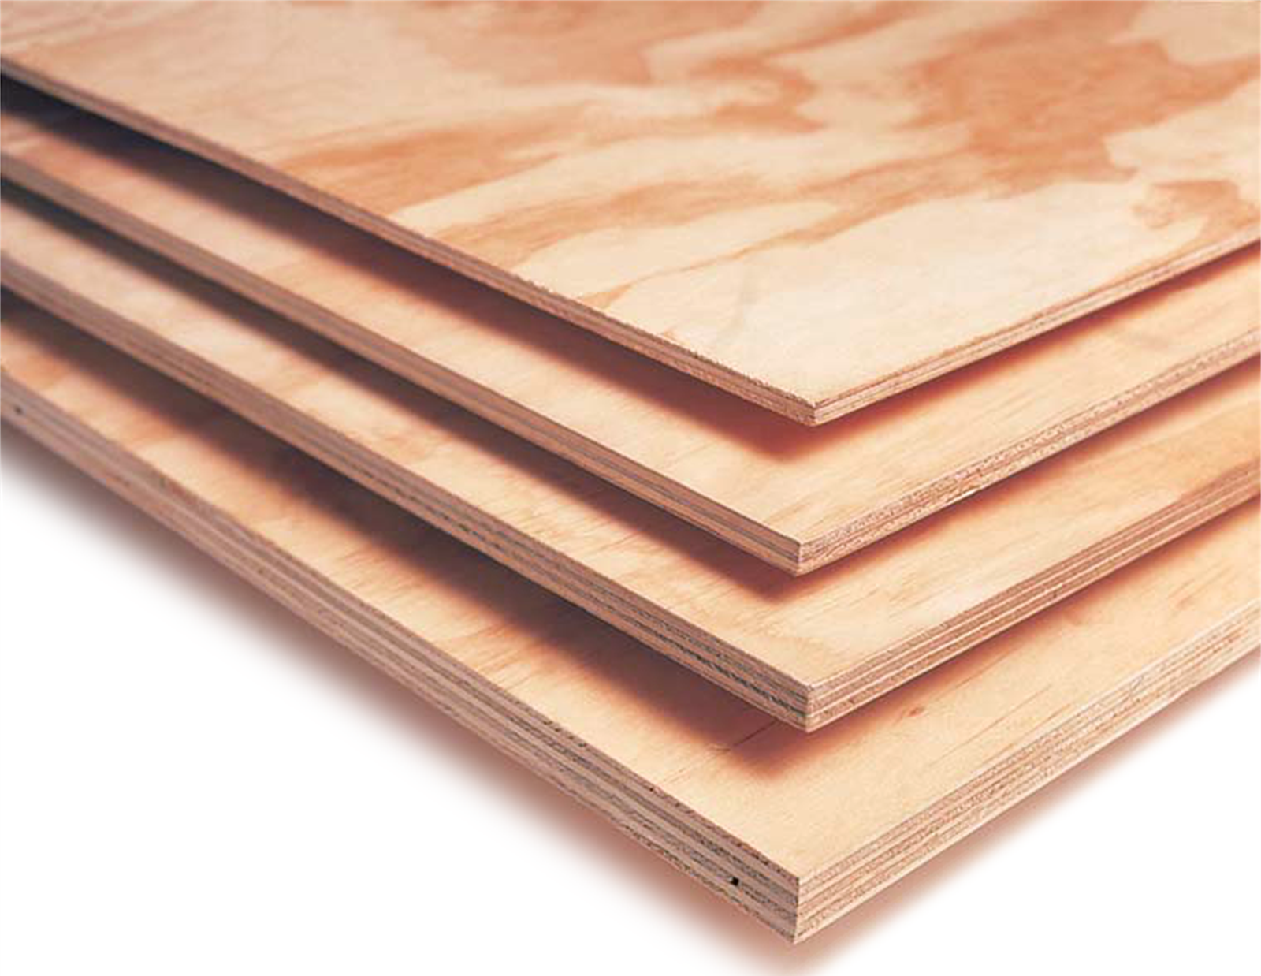
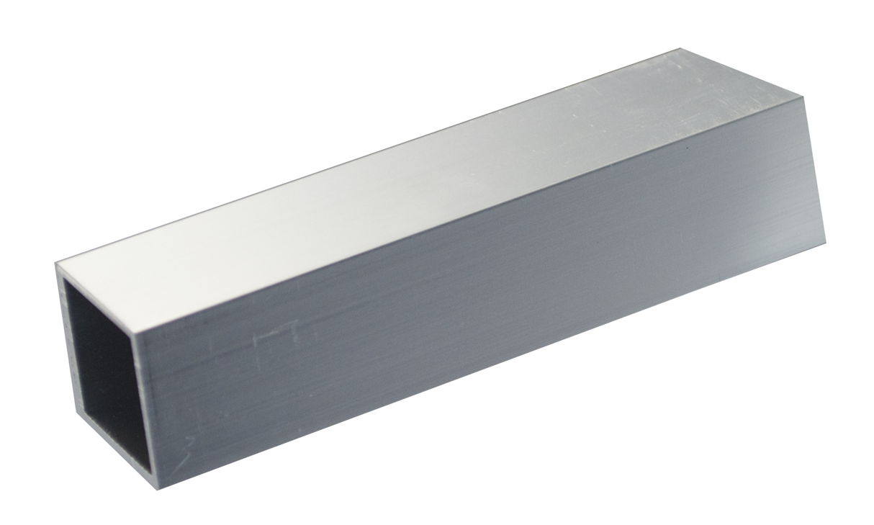
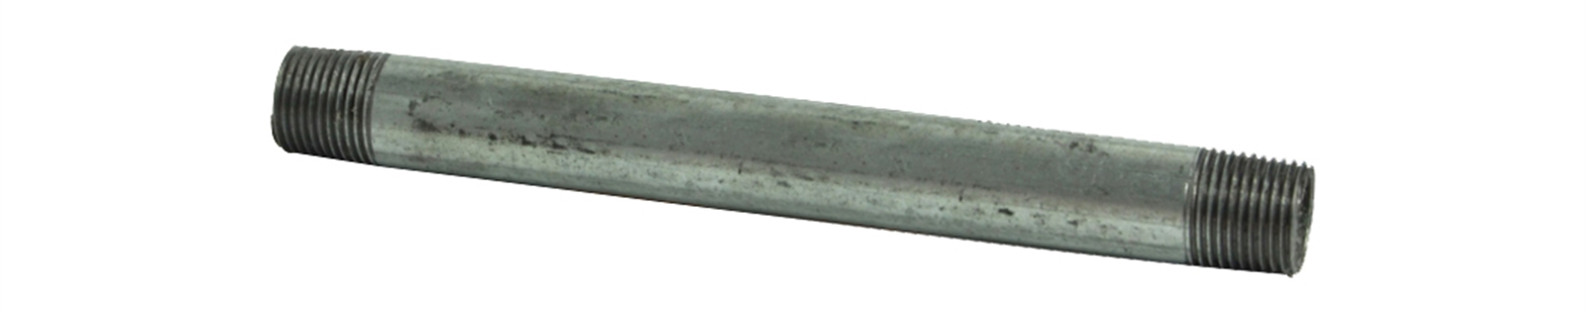
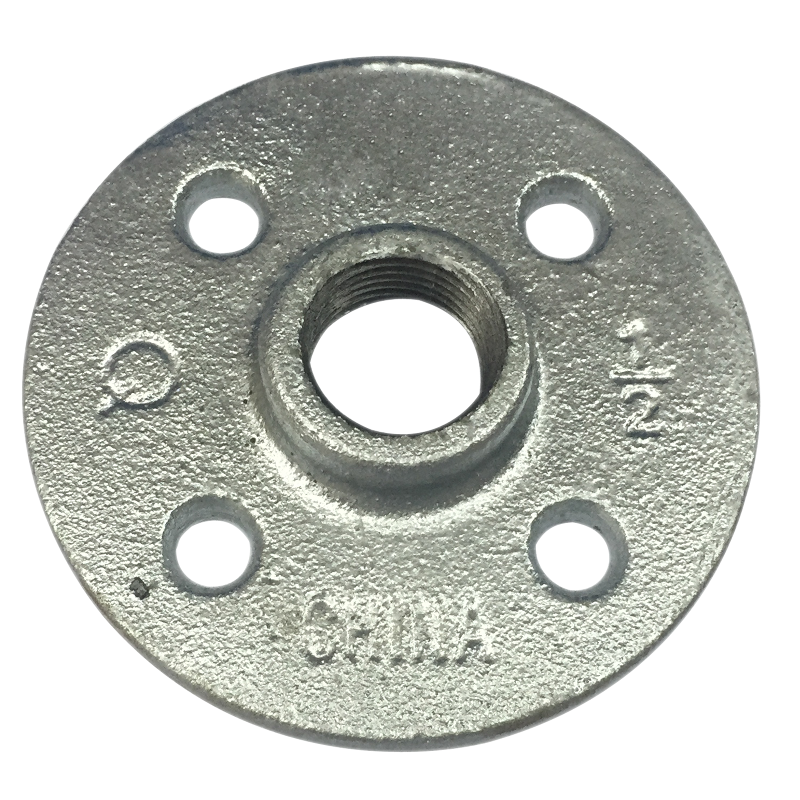
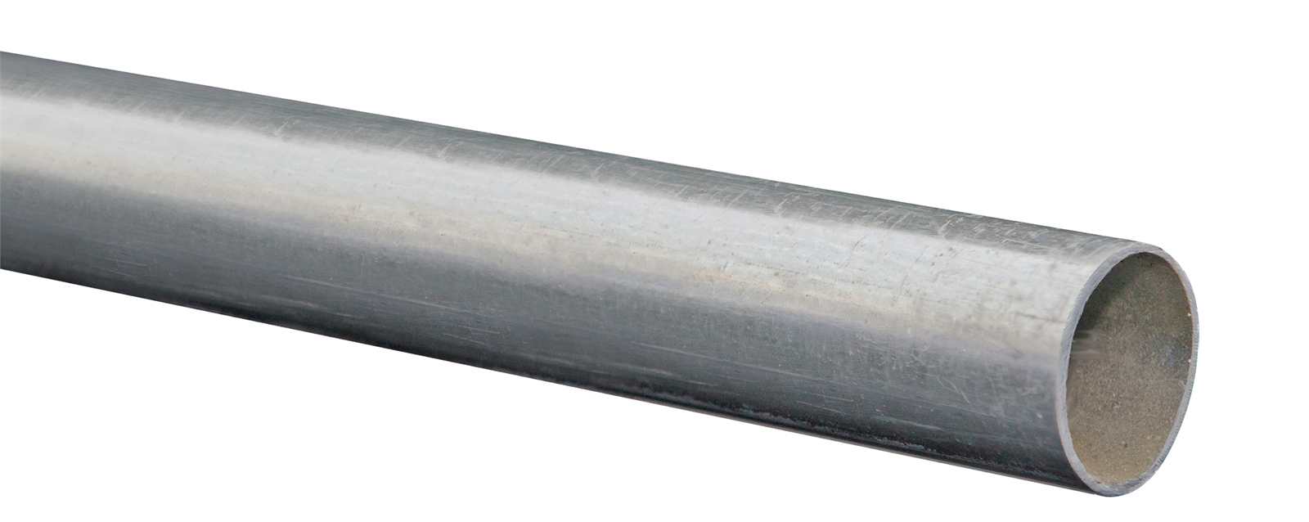
Materials
300x300x5mm plywood | x1
19mm aluminium box section (500mm long) | x1
15mm x 200mm pipe | x1
15mm pipe flange | x1
31.8x1.2mm steel tubing (3m long) | x1

Slide 7
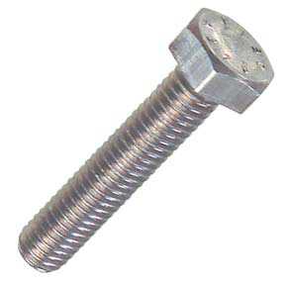
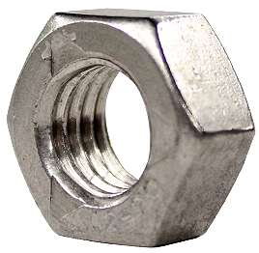
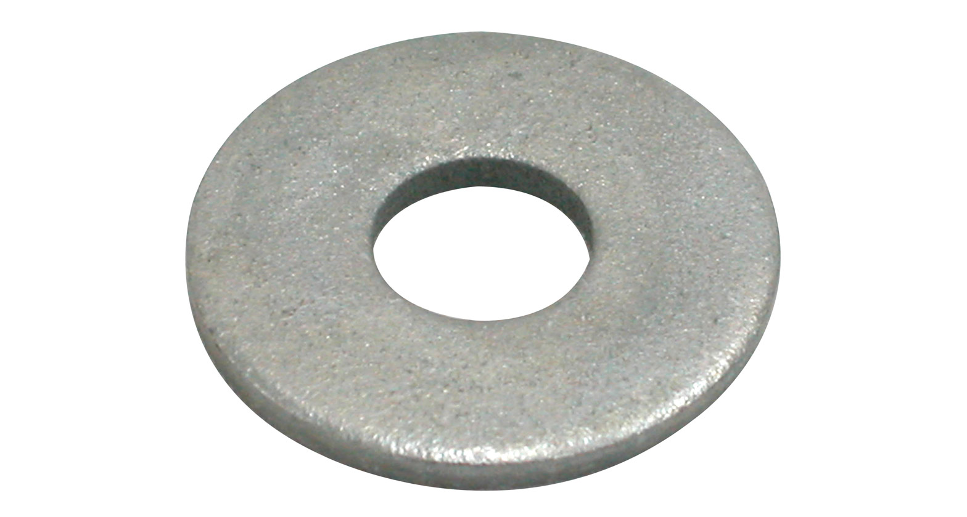
Fasteners
Bolts: M16x100mm M7x20mm M5x25mm M5x35mm 0.5”x1.5” | x1 x4 X10 X4 x4
Nuts: M16 M7 M5 0.5” | x1 x4 X14 x4
Washers: M7 M5 0.5” | x4 X14 x4

